Slide 1
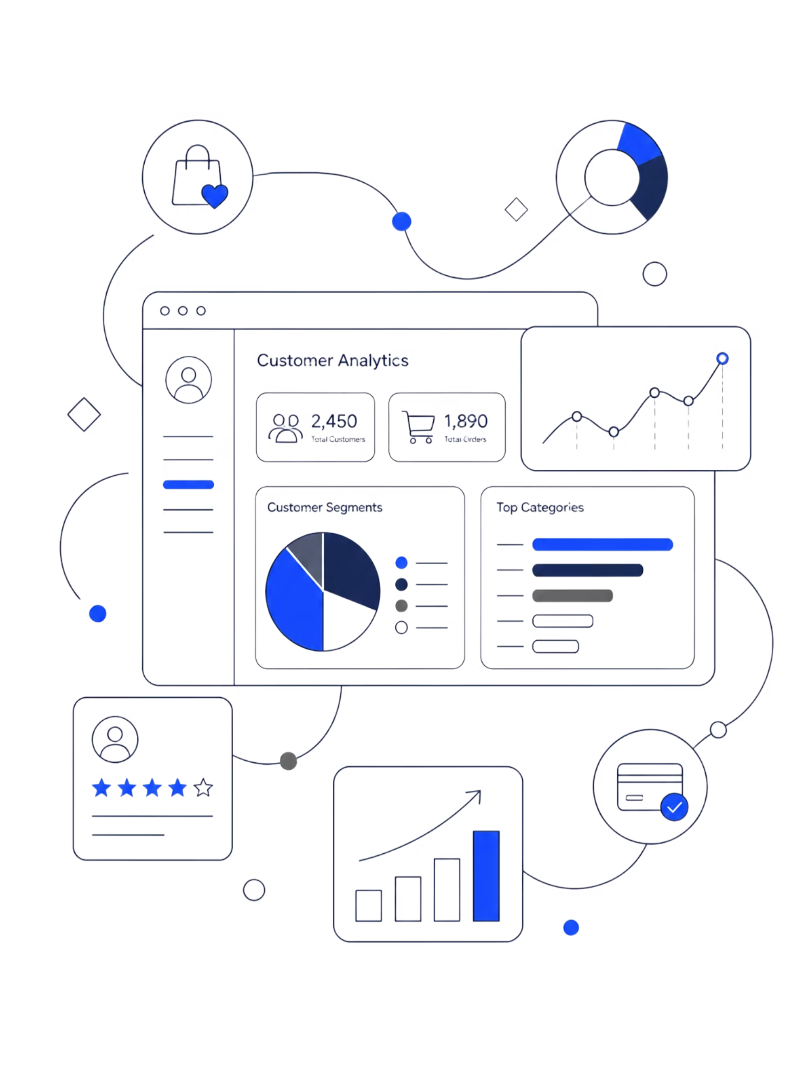
Customer Shopping Behavior Analysis
Uncovering insights from 3,900 transactions to drive smarter marketing and business strategy

Slide 2
Dataset at a Glance
3,900
18
37
Transactions
Columns
Missing Values
Review Rating column
Customer Demographics
Purchase Details
Age, Gender, Location, Subscription Status
Item, Category, Amount, Season, Size, Color
Shopping Behavior: Discount Applied, Promo Code, Previous Purchases, Frequency, Review Rating, Shipping Type

Slide 3
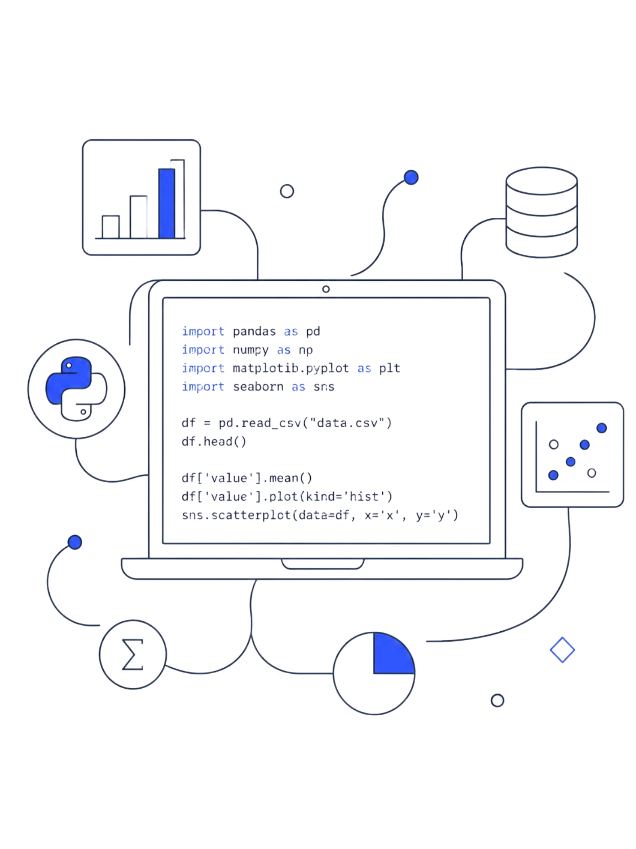
Data Preparation in Python
01
02
Load & Explore
Handle Missing Data
Pandas import, df.info(), .describe()
Imputed Review Rating using median per category
03
04
Standardize & Engineer
Load to PostgreSQL
Snake_case columns, age_group bins, purchase_frequency_days
Cleaned DataFrame loaded for SQL analysis

Slide 4
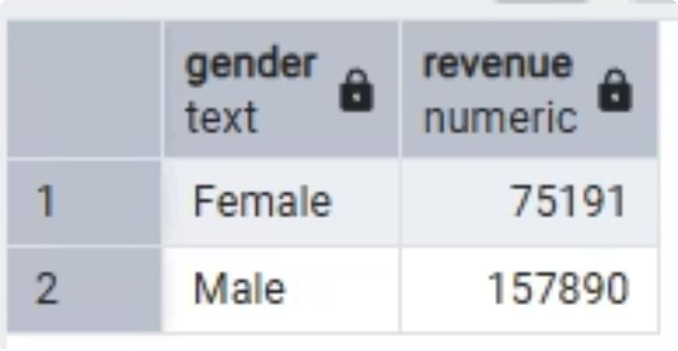
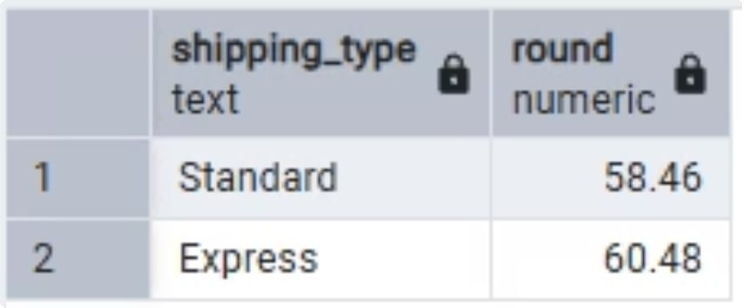
Revenue by Gender & Shipping Type
Revenue by Gender
Males generate 2X the revenue than females
Shipping Type Comparison with Average Purchase Amount
No distinct difference between shipping type benefit

Slide 5
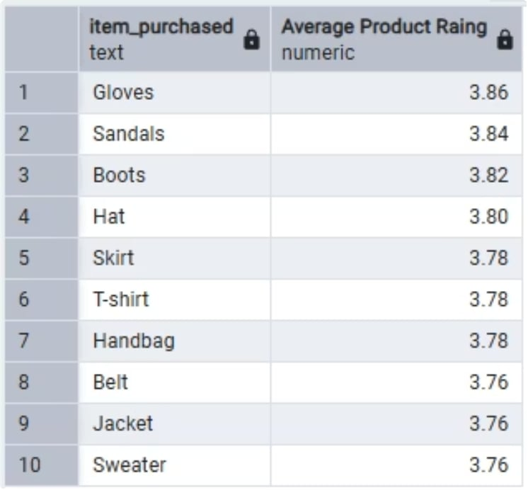
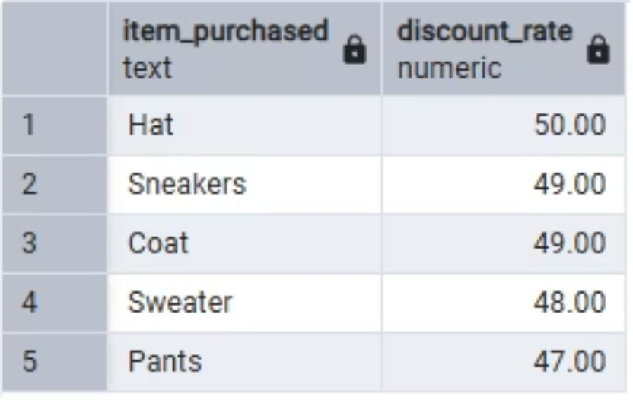
Discount Behavior & Top-Rated Products
Top 10 Products by Rating
Products with the highest average review ratings
Glover, Sandals, Boots, Hat, Skirt, T-Shirt, Handbag, Belt, Jacket, Sweater
Top 5 Discount-Dependent Products
Items with the highest percentage of purchases with discounts applied

Slide 6
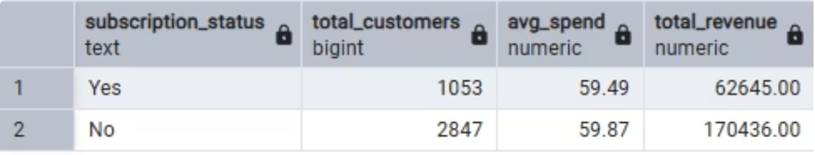
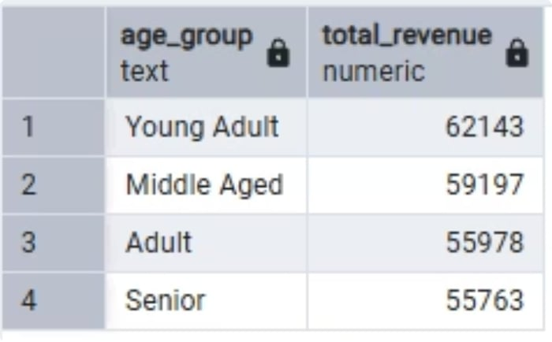
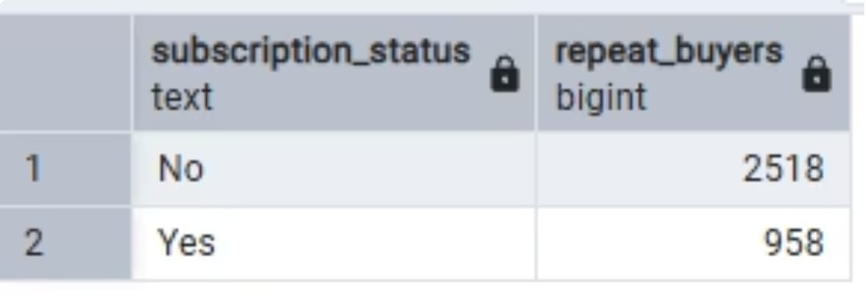
Subscription & Age Group Insights
Subscription Status
Non subscription customers are 2.7 times than subscribers.
Revenue generated by non subscribers are also 2.7 times.
Revenue by Age Group
Young Adults are the top revenue-contributing age group
Repeat Buyers & Subscription
Customers with >5 previous purchases are not subscribers yet

Slide 7
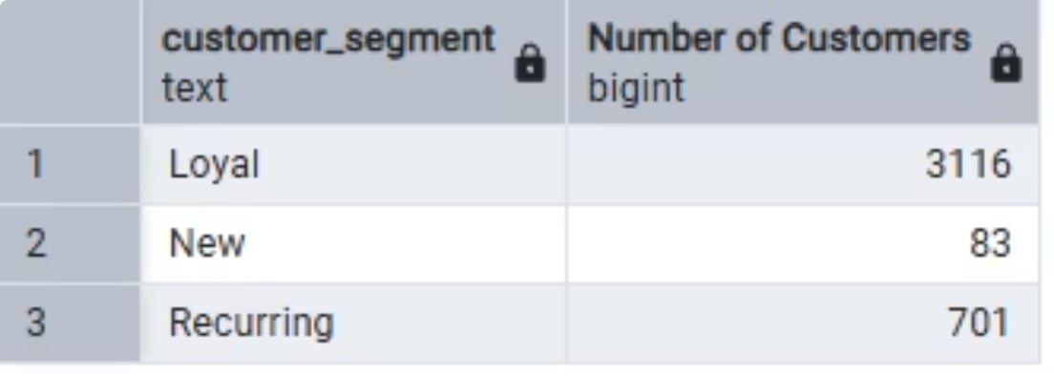
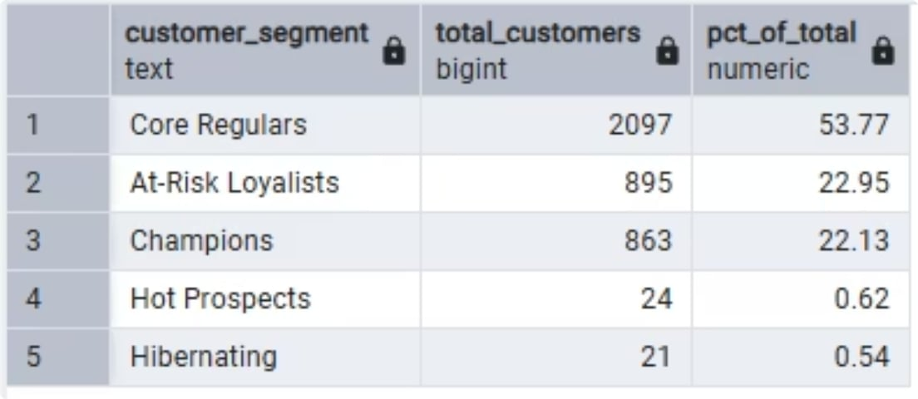
Customer Segmentation
Frequency-Based Segments
79% of customer base are “Loyal” customers
Recency + Frequency Segments
Key segments to focus are Core Regulars, At-Risk Loyalist, and Champions.

Slide 8
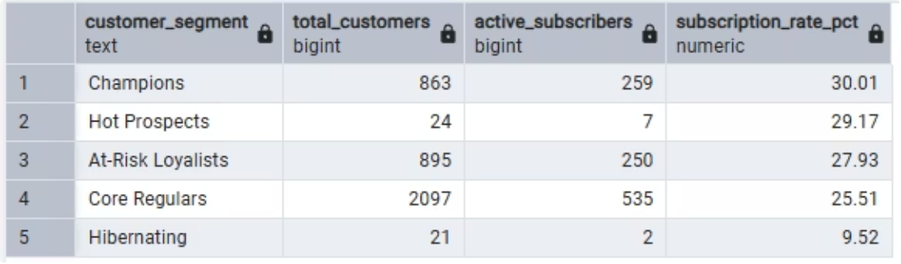
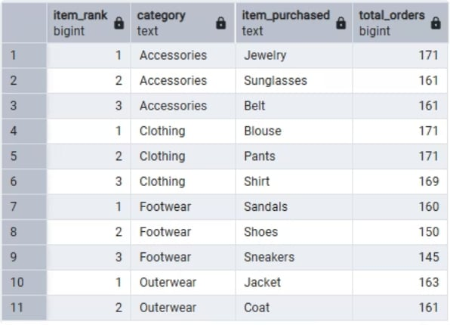
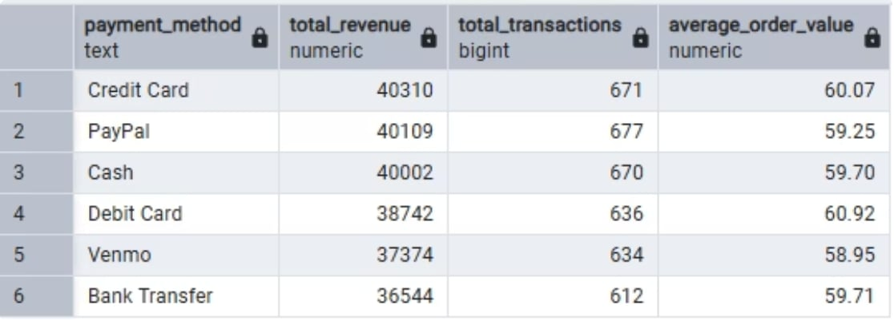
Segments, Categories & Payment Methods
Segment Subscription Rates
Breakdown of subscription rates across customer segments
Top 3 Products per Category
Most purchased products within each category by order count
Payment Method Revenue
Credit Card drives the highest purchase amounts

Slide 9
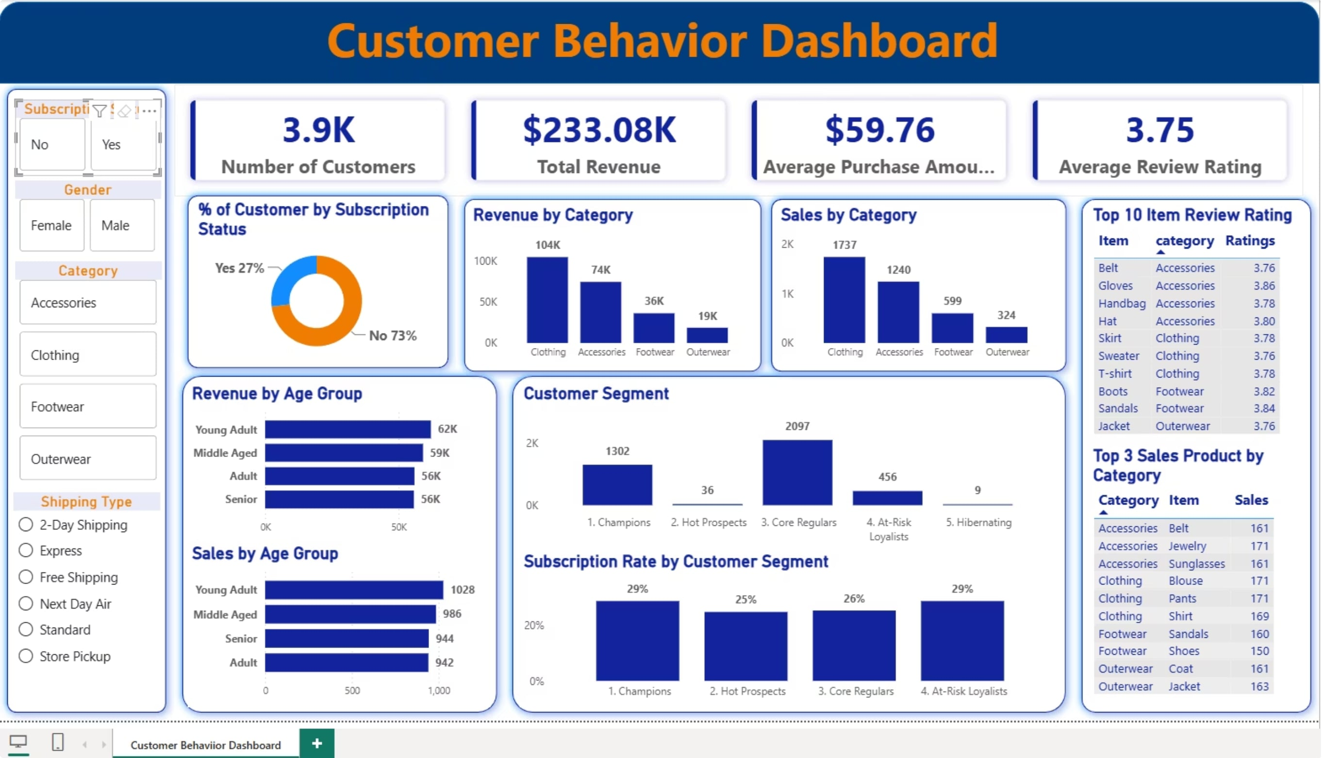
Power BI Dashboard

Slide 10
Business Recommendations
Boost Subscriptions
Loyalty Program
Review Discounts
Exclusive benefits to convert non-subscribers and increase spending
Reward repeat buyers into "Loyal" segment. Create engagement through games with “Core regulars”.
Balance sales boosts with margin control. Curate budget catered for various customer segmentation for efficient spending.
Product Positioning
Target Marketing
Highlight top-rated, best-selling products. Build Top-of-the-Mind awareness.
Focus on high-revenue age groups & express shipping users.
Partnerships
Partner up with credit card payment brands to offer diverse payment plans, rewards and discount.

